Slide 1
Données pour DR IAM: RABAT - AVANZIT
Lignes: 16 | ST FO: AVANZIT

Slide 2
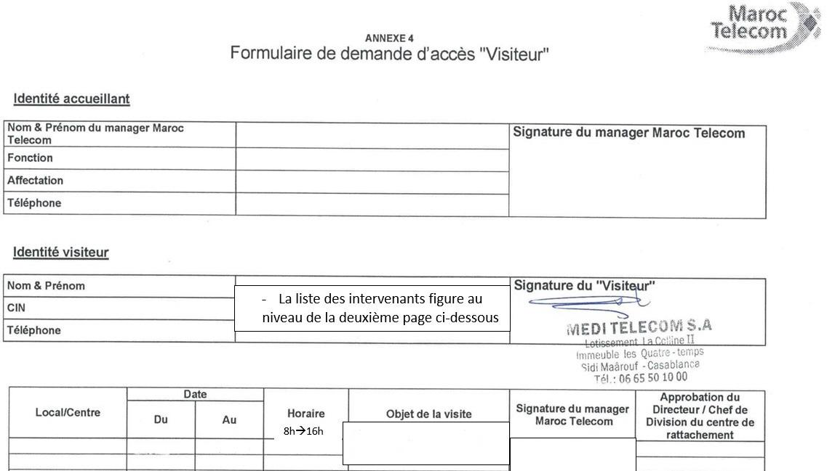
code site | ST FO | contact ERPT | DR IAM | ville | X Départ ERPT - Y Départ ERPT | X Arrivée ERPT Proposition1 - Y Arrivée
RAB1167 | AVANZIT | 0660127763 AZEDDINE | RABAT | RABAT | 33.986861°, -6.800111° | 33.986958°, -6.802556°
KEN023 | AVANZIT | 0660127763 AZEDDINE | RABAT | KENITRA | 34.28486611, -6.60890066 | 34.27583333, -6.61138889
KEN070 | AVANZIT | 0660127763 AZEDDINE | RABAT | KENITRA | 34.25244433, -6.52158981 | 34.24736600, -6.54666200
KEN1040 | AVANZIT | 0660127763 AZEDDINE | RABAT | KENITRA | 34.25759010, -6.55197853 | 34.24930300, -6.55527600
KEN1049 | AVANZIT | 0660127763 AZEDDINE | RABAT | KENITRA | 34.26189000, -6.57102000 | 34.26331500, -6.57105200
KEN1052 | AVANZIT | 0660127763 AZEDDINE | RABAT | KENITRA | 34.23416800, -6.52999800 | 34.23914016, -6.54668213
KEN1058 | AVANZIT | 0660127763 AZEDDINE | RABAT | KENITRA | 34.21948965, -6.61459172 | 34.23427898, -6.61676285
KEN1075 | AVANZIT | 0660127763 AZEDDINE | RABAT | KENITRA | 34.22774847, -6.54663547 | 34.23819807, -6.55612815
KEN1080 | AVANZIT | 0660127763 AZEDDINE | RABAT | KENITRA | 34.25117351, -6.55618354 | 34.25101400, -6.55682100
KEN1090 | AVANZIT | 0660127763 AZEDDINE | RABAT | KENITRA | 34.23286800, -6.61573200 | 34.23424651, -6.61654371
KEN1092 | AVANZIT | 0660127763 AZEDDINE | RABAT | KENITRA | 34.22956650, -6.53120207 | 34.23914016, -6.54668213
KEN151 | AVANZIT | 0660127763 AZEDDINE | RABAT | KENITRA | 34.22355450, -6.53557198 | 34.22956650, -6.53120207
KEN157 | AVANZIT | 0660127763 AZEDDINE | RABAT | KENITRA | 34.23029592, -6.58079417 | 34.23614002, -6.57165421
KEN943 | AVANZIT | 0660127763 AZEDDINE | RABAT | KENITRA | 34.25123900, -6.57213600 | 34.25374700, -6.57989500
KEN976 | AVANZIT | 0660127763 AZEDDINE | RABAT | KENITRA | 34.22881593, -6.53457249 | 34.23109200, -6.53366300
KEN988 | AVANZIT | 0660127763 AZEDDINE | RABAT | KENITRA | 34.26884038, -6.59386139 | 34.27361100, -6.59147200

